Slide 1
Static resources & Templating
ReDI School
Backend - Autumn 2025

Slide 2
Previously
Backend server
FastAPI framework
GET / POST / PUT / DELETE

Slide 3
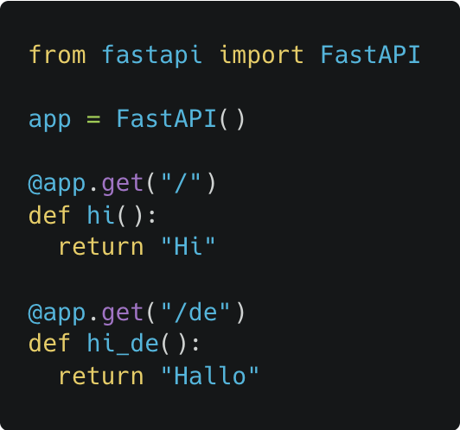
FastAPI

Slide 4
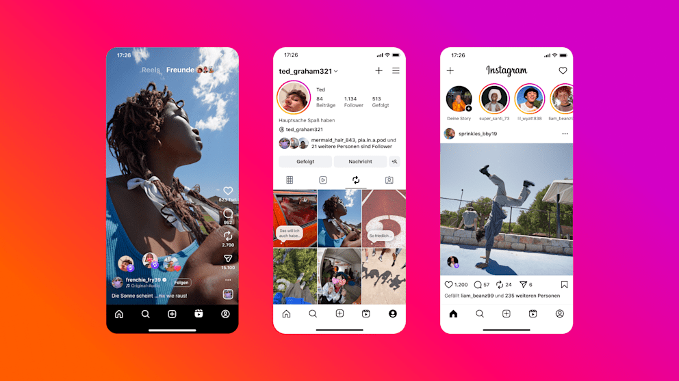
How to serve files?
Images
Videos
CSS, JS and any other files
Notes:
We made a backend server last time and saw API

Slide 5

get logo API
GET http://127.0.0.1:8000/logo
FastAPI server

Slide 6
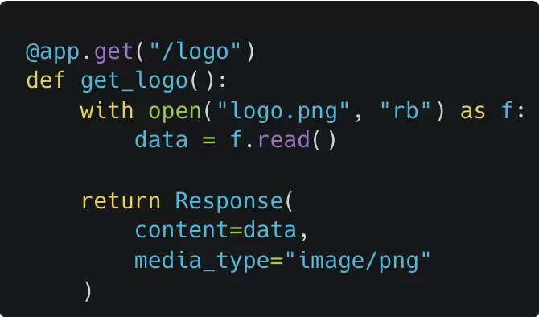
get logo API
Bad😿
GET http://url/logo
FastAPI server
1. read file
2. return bytes

Slide 7
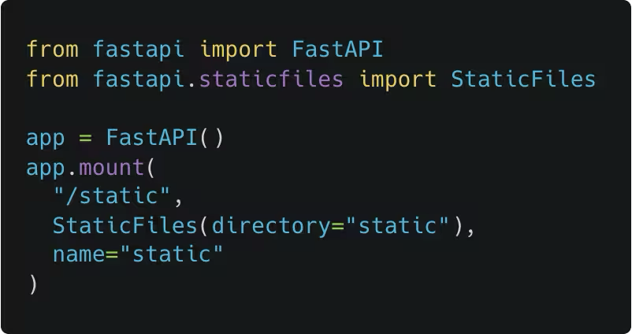
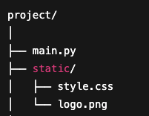
get logo API
Good😸
GET http://url/logo
FastAPI server
Mount directory

Slide 8
Static files with FastAPI demo

Slide 9
Why FastAPI static?
Fast
Best practices
Convenient

Slide 10
Why FastAPI static?
Fast
syscall vs Python
async
Best practices
file chunking
headers (file size, caching)
error handling
Convenient

Slide 11



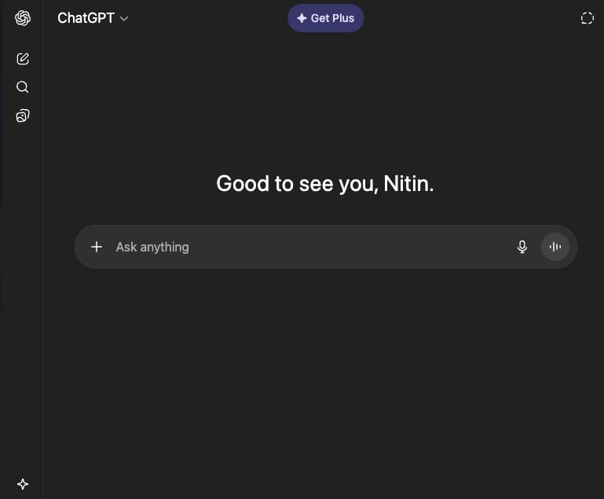
Backend
chatgpt.com
chatgpt.com
chat.html

Slide 12
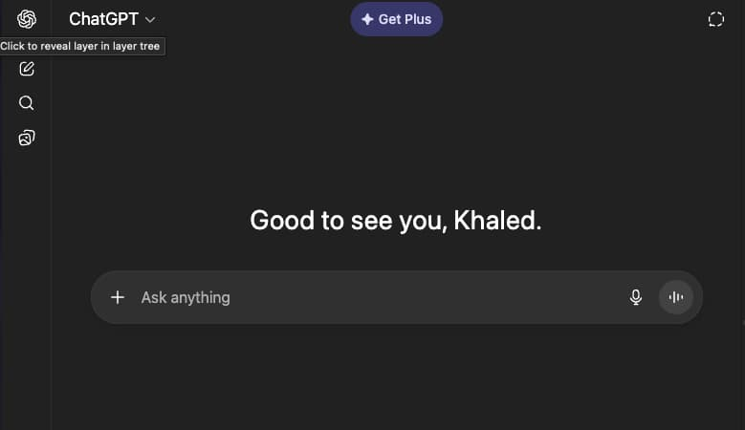
Backend
chatgpt.com
chatgpt.com
chat.html
What if we want dynamic content?
chat1.html, chat2.html?

Slide 13
Template files

Slide 14
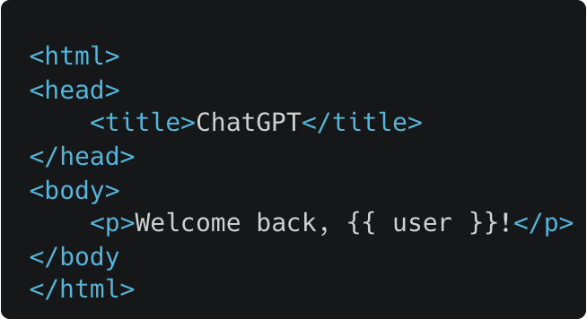
HTML template (templates/chat.html)

Slide 15
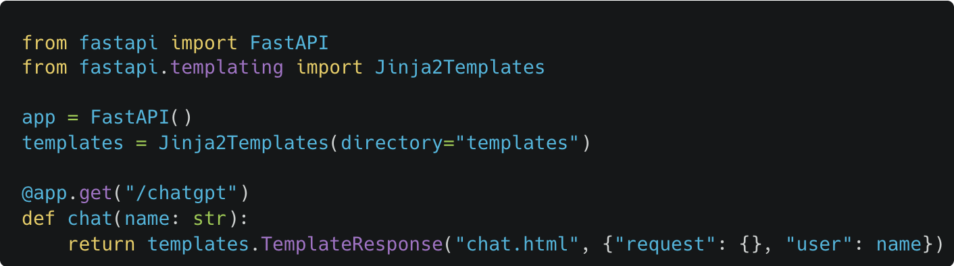
FastAPI - serving template files
Try at http://127.0.0.1/chatgpt?name=Rohan
Notes:
Jinja is a templating engine with a lot of functionality

Slide 16

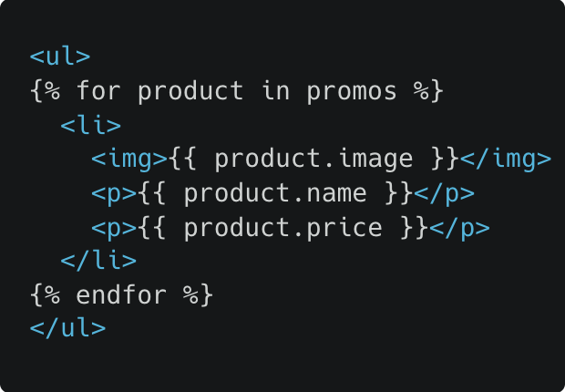
Templating use cases
Loops

Slide 17
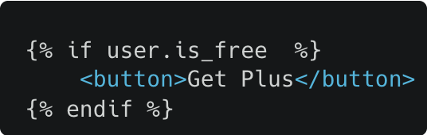
Templating use cases
Conditions

Slide 18
Templating practical application
UI server
javascript frameworks like React
chatgpt.com
chat.html
get user
Data server
python / java ... frameworks
Nitin

Slide 19

Files aren't usually served from Python

Slide 20
Templating practical application - SSR
Server Side Rendering
UI server
Dynamic data
Data server

Slide 21
Serving files - best practices
For static files:
CDNs (content delivery network)
browser cache
For dynamic elements:
Javascript returned by the UI server calls the data server for more information
Server side rendering (SSR) by UI frameworks

Slide 22
Serving dynamic files
600 million products
9 million sellers
Large scale data!
Databases (coming next)

Slide 23

Feedback
Scan the QR code or go to: https://redischool.typeform.com/lessonfeedback

